Slide 1
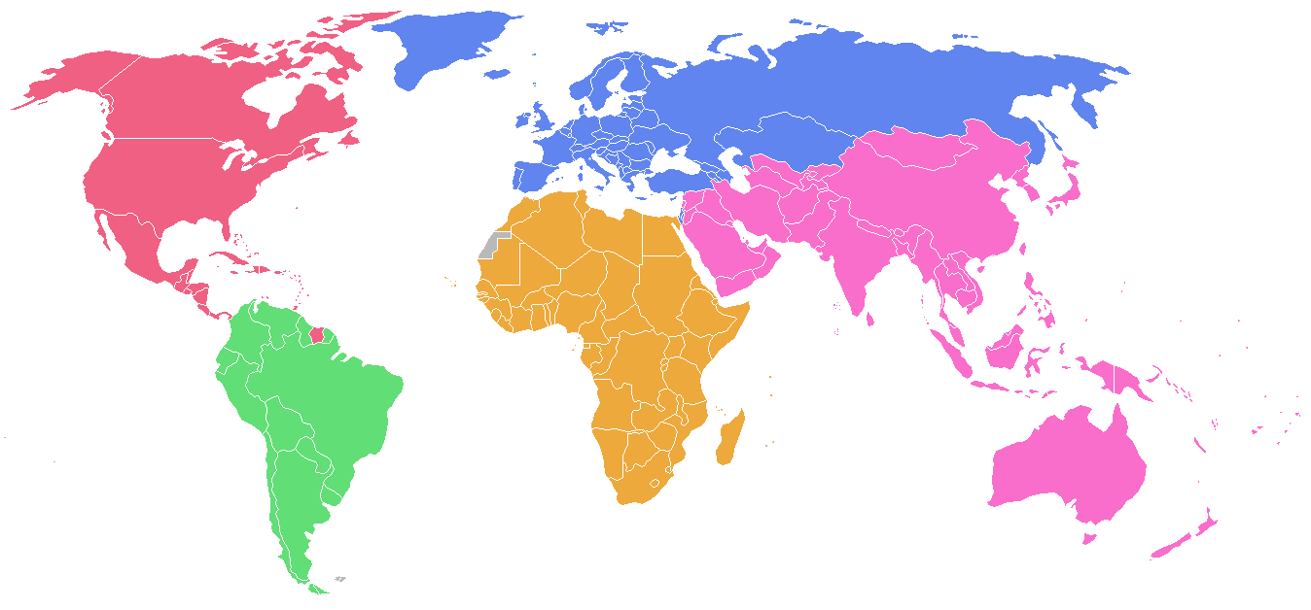
Economies from a Historical Perspective

Slide 2
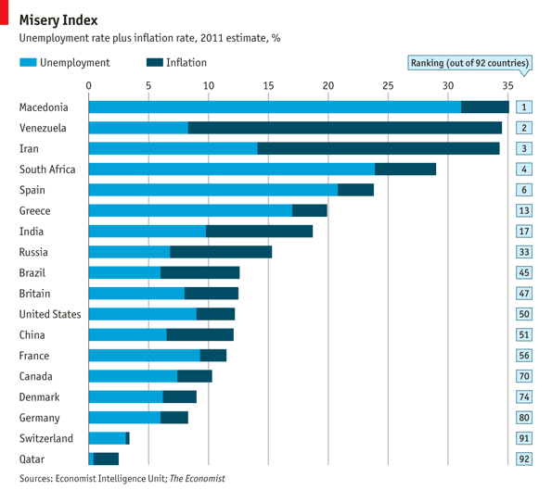
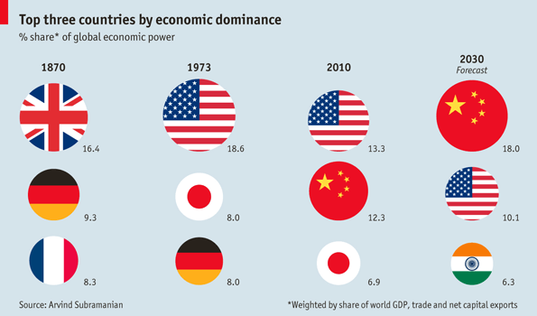
http://www.economist.com/blogs/dailychart/2011/09/global-economic-dominance

Slide 3
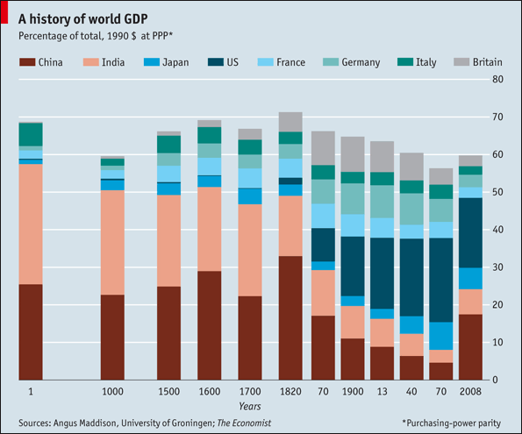
http://www.economist.com/node/16834943

Slide 4
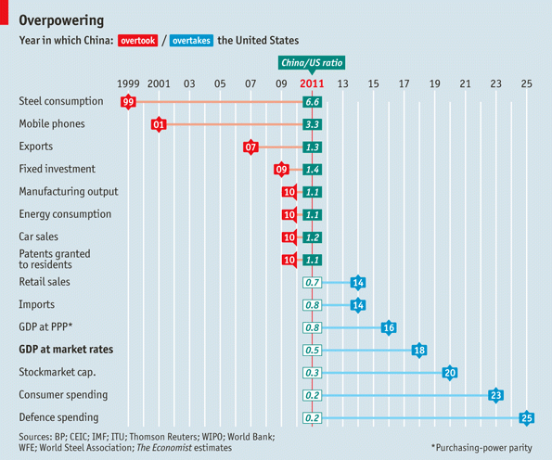
http://www.economist.com/node/21542155?fsrc=nlw|hig|12-28-2011|editors_highlights

Slide 5
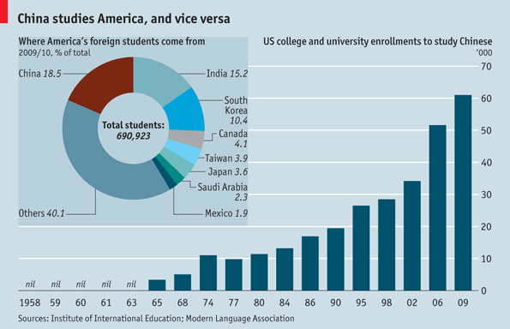
http://www.economist.com/blogs/dailychart/2011/01/china_and_america

Slide 6
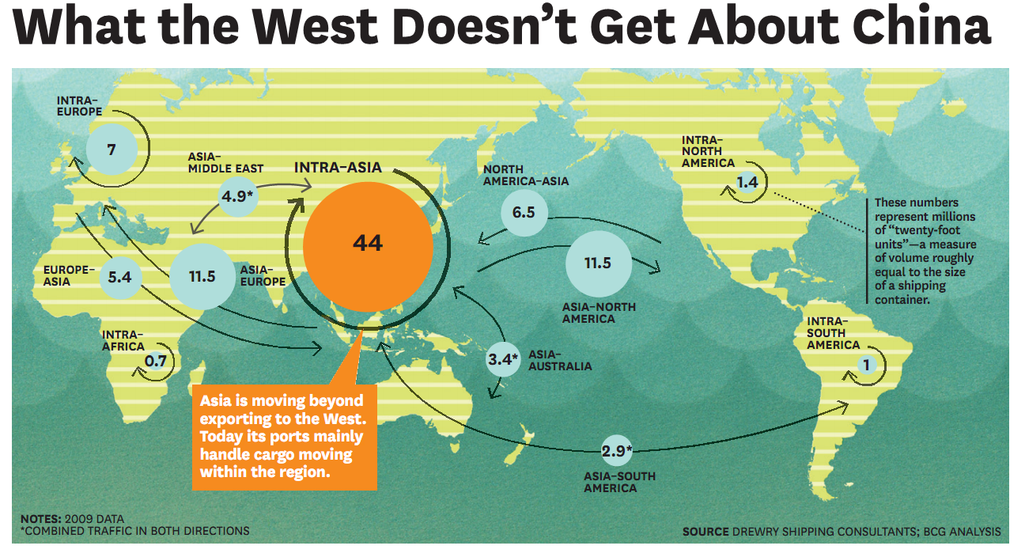

Slide 7
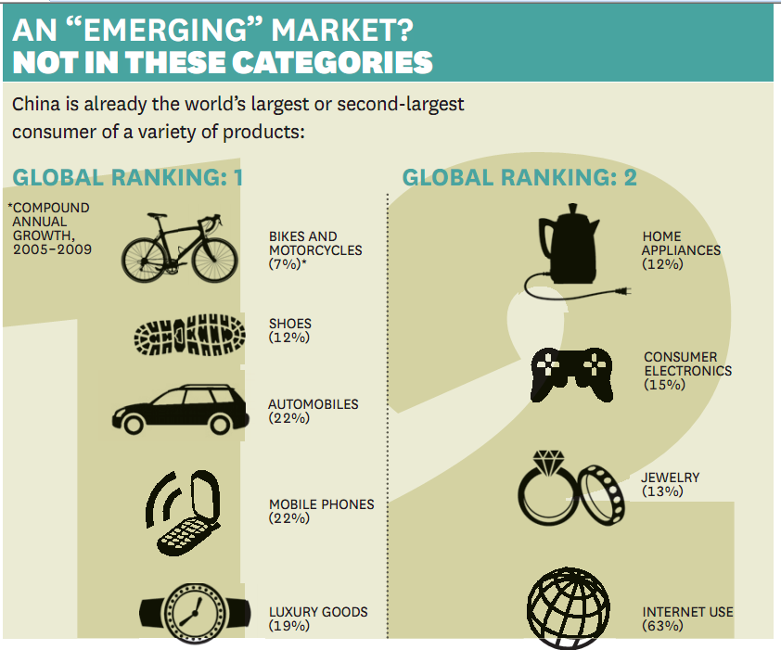

Slide 8


